Slide 1

A PROJECT REPORT
on
“Stress and Depression Detection via Social Media Using Machine Learning”
Submitted to the
SAVITRIBAI PHULE PUNE UNIVERSITY
IN PARTIAL FULFILLMENT FOR THE AWARD OF THE DEGREE OF
BACHELOR OF ENGINEERING
Information Technology
By
Ashutosh Todkar (B190658563)
Pranit Vichare (B190658564)
Rushikesh Gadhave (B190658519)
Prasad Ghodake (B190658521)
UNDER THE GUIDANCE OF
Prof. A. G. Kadam
DEPARTMENT OF INFORMATION TECHNOLOGY
TRINITY COLLEGE OF ENGINEERING AND RESEARCH,PUNE
NEAR KHADI MACHINE CHOWK, KONDHWA ANNEX,PUNE-411048
2023-2024

Slide 2
CONTENTS
Motivation
Introduction
Problem statement
Literature survey
Gap Analysis
System Architecture
Proposed algorithm
Mathematical model.
SDLC Model
Component diagram
Deployment diagram
System requirement
Screenshots of implemented modules
Screenshots of project output.
Advantages and Limitations
Conclusions
Future work.
References

Slide 3
MOTIVATION
The Mental sickness is considered to be a major factor of change mood of a user and user goes into a depression or stress.
Now a days user can be mentally disturb due to social interactions of social networks.
The rapid increase of mental sickness has become a great challenge to human health and life quality.
Thus, there is significant importance to detect mental sickness before it turns into severe problems.

Slide 4
INTRODUCTION
The number of active users of online social networks (OSN) it has grown considerably.
This maximum the number of users, in OSN, is mainly due to the increase of number of mobile devices, such as smartphones and tablets, connected to the Internet.
Currently, the OSN has become a rich man and universal means to express opinions, feelings and reflect each user's bad habits or wellness practices.
In recent years, the analysis of messages published in OSN has been used by many applications in the field of health informatics.
The feelings and emotions expressed in the messages published in OSN, provides clues on various aspects of user behaviour for example, sentences containing words with negative meaning it can indicate sadness, stress or dissatisfaction.

Slide 5
Our system, find user’s depression, stress and positive and negative comments.
we employ a large-scale dataset from real-world social platforms to systematically study the correlation of user’s psychological disorder states and social interactions.
Extended use of social networks like Twitter, Facebook lets people share their every day moods on it.
We may recognize words from social media data -
Pronouns such as: “I”
Verbs such as: “am” “feel”
Adjectives such as: “ugly” “sad”

Slide 6
PROBLEM STATEMENT
To design a system to find depressed users via social media network and to find positive and negative comments using sentiment analysis.

Slide 7
LITERATURE SURVEY
Sr No | Title | Author | Journal | Description
1 | Multimodal Hierarchical CNN Feature Fusion for Stress Detection | Radhika Kuttala, Ramanathan Subramanian, Venkata Ramana Murthy | IEEE 2023 | The recent coronavirus disease (COVID-19) has become a pandemic and has affected the entire globe. During the pandemic, they observed a spike in cases related to mental health, such as anxiety, stress, and depression. They propose the following: 1) an extrinsic feature by harnessing the URLs present in tweets and 2) extracting textual content present in images posted in tweets.
2 | A Multimodel framework for depression detection during covid 19 via harvesting social media | Ashutosh Anshul, Gumpili Sai Pranav, Zia Ur Rehman. | IEEE 2023 | This paper presents a multimodal framework for detecting depression during the COVID-19 pandemic by leveraging social media data. It integrates various data sources and employs advanced analytics to identify depressive symptoms, offering insights for mental health monitoring and support strategies.

Slide 8
LITERATURE SURVEY
3 | A Knowledge-Based Recommendation System that includes Sentiment Analysis and Deep Learning | Renata L. Rosa, Gisele M. Schwartz, Wilson V. Ruggiero, and Dem´ostenes, Z. Rodr´ıguez, Senior Member, IEEE | IEEE 2019 | Online social networks (OSN) provide relevant information on users’ opinion about different themes. Thus, applications, such as monitoring and recommendation systems (RS) can collect and analyze this data. This paper presents a Knowledge-Based Recommendation System (KBRS), which includes an emotional health monitoring system to detect users with potential psychological disturbances, specifically, depression and stress.
4 | Emotion-Semantic Enhanced Neural Network | Guang Yang, Haibo He, Fellow, IEEE, and Qian Chen | IEEE 2019 | Sentiment analysis on microblog posts has been studied in depth, sentiment analysis of posts is still challenging because of the limited contextual information that they normally contain. In microblog environments, emoticons are frequently used and they have clear emotional meanings. They are important emotional signals for microblog sentimental analysis. They address this issue by constructing an emotional space as a feature representation matrix and projecting emoticons and words into the emotional space based on the semantic composition.

Slide 9
LITERATURE SURVEY
5 | Detecting Stress Based on Social Interactions in Social Networks | Huijie Lin, Jia Jia, Jiezhon Qiu, Yongfeng Zhang, Lexing Xie, Jie Tang, Ling Feng, and Tat-Seng Chua | IEEE 2017 | In this paper, we find that users stress state is closely related to that of his/her friends in social media, and we employ a large-scale dataset from real-world social platforms to systematically study the correlation of users’ stress states and social interactions. We first define a set of stress-related textual, visual, and social attributes from various aspects, and then propose a novel hybrid model - a factor graph model combined with Convolutional Neural Network to leverage tweet content and social interaction information for stress detection

Slide 10
GAP ANALYSIS
Current State:
Facebook text data detection.
Use of separate application.
Sentiment analysis used for text.
Desired Future State:
Data from multiple social sites.
Integration of app in Facebook.
Integration of sentiment analysis for images and audio.
Identified Gaps:
Limited Facebook dataset.
Seperate application required.
No sentiment analysis for image or audio.

Slide 11
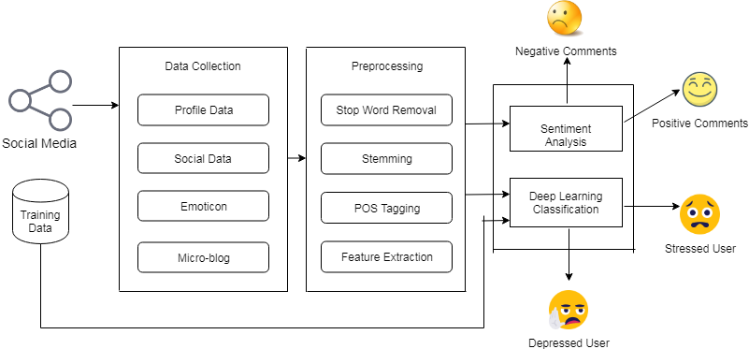
SYSTEM ARCHITECTURE

Slide 12
PROPOSED ALGORITHM
Naive Bayes
Given training dataset D which consists of documents belonging to different class say Class A and Class B
Calculate the prior probability of class A=number of objects of class A/total number of objects
Calculate the prior probability of class B=number of objects of class B/total number of objects
Find NI, the total no of frequency of each class
Na=the total no of frequency of class A
Nb=the total no of frequency of class B
Find conditional probability of keyword occurrence given a class:

Slide 13
PROPOSED ALGORITHM
P (value 1/Class A) =count/ni (A)
P (value 1/Class B) =count/ni (B)
P (value 2/Class A) =count/ni (A)
P (value 2/Class B) =count/ni (B)
P (value n/Class B) =count/ni (B)
Avoid zero frequency problems by applying uniform distribution
Classify Document C based on the probability p(C/W)
Find P (A/W) =P (A)*P (value 1/Class A)* P (value 2/Class A)……. P(value n /Class A)
Find P (B/W) =P (B)*P (value 1/Class B)* P (value 2/Class B)……. P(value n /Class B)
Assign document to class that has higher probability.

Slide 14
MATHEMATICAL MODEL
The mathematical model for Stress and Depression Monitoring System is as-
S={I, F, O}
Where,
I = Set of inputs
The input consists of set of Words/Emoticon/Microblog. It uses Twitter and Facebook dataset.
F = Set of functions
F={F1, F2, F3….FN}
F1: Data Collection
Where,
T- Twitter
F-Facebook

Slide 15
MATHEMATICAL MODEL
F2: Sentimeter
Sentimeter detects stress by analyzing sentiment in Facebook posts and interactions using NLP and ML techniques.
Sentiment Intensity (S)=∑i=1p​SUi​+∑j=1q​SBj​+∑k=1r​STk
F3: Sentiment Analysis
Where,
W – Words
N – Naïve Bayes
F4: Classification
Where,
W – Words
RNN – Recurrent Neural Network
O=Find Disorder (i.e. Positive comments, Negative comments, Stressed user, Depressed user)

Slide 16
SDLC MODEL
Waterfall Model for SDD ML (Post-Completion)
1. Requirements Analysis
- Review user feedback and performance metrics
- Define requirements for potential improvements
2. System Design
- Update system architecture for integrating new features.
- Plan UI/UX enhancements based on feedback
3. Implementation
- Expand the dataset to include more diverse and comprehensive social media data.
- Implement sentiment analysis techniques and keyword search capabilities
4. Integration and Testing
- Perform comprehensive testing on new features
- Conduct regression testing to ensure existing functionalities remain stable
5. Deployment
- Deploy updates and enhancements to the production environment
- Monitor the deployment for any issues and gather user feedback to ensure the changes meet user needs.
6. Maintenance
- Regularly monitor system performance and user satisfaction
- Continuously update and refine the datasets, algorithms, and features based on user feedback and performance metrics.

Slide 17
COMPONENT DIAGRAM

Slide 18
DEPLOYMENT DIAGRAM

Slide 19
SYSTEM REQUIREMENTS
Hardware Specification:
  Processor – Intel i3/i5/i7
  RAM – 2GB(min)
  Hard Disk – 40GB
Software Specification:
1. Operating system: Window 7,8,10.
2. Application Server: Apche Tomcat 7/8/9
3. Front End: HTML, JSP, CSS, Bootstrap
4. Scripts: JavaScript.
5. Database: MySQL
6. IDE: Elipse

Slide 20
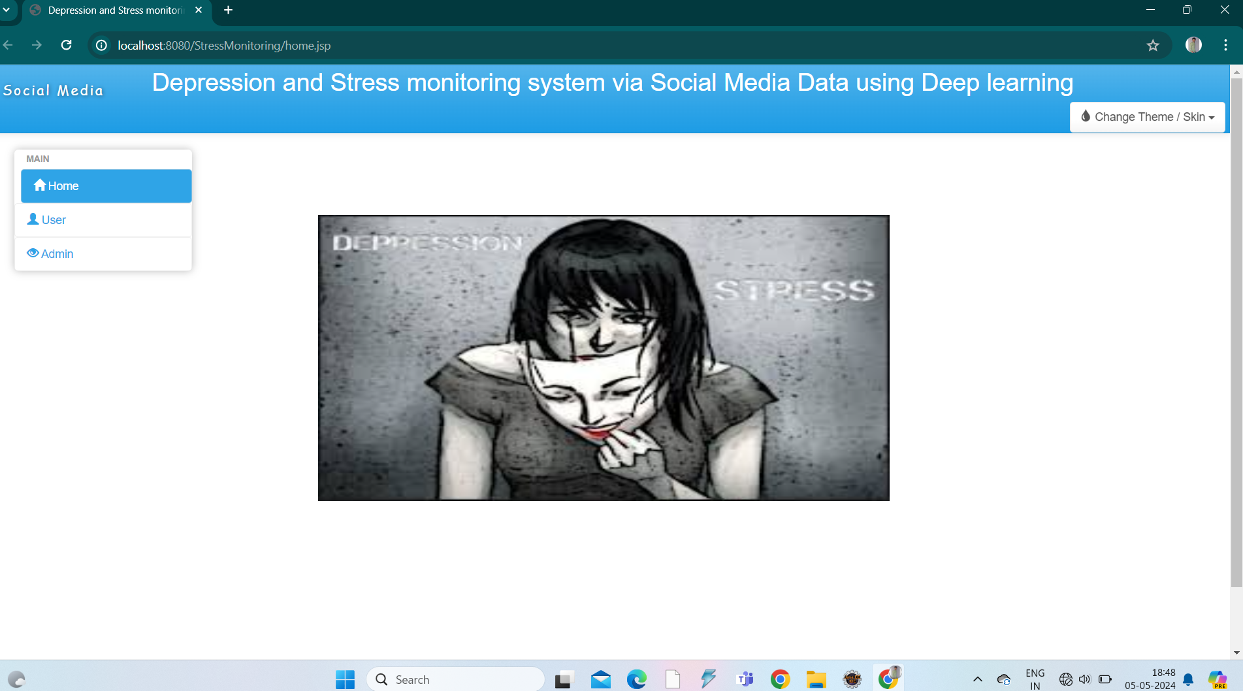
Screen shots of implemented modules of project
Home Page

Slide 21
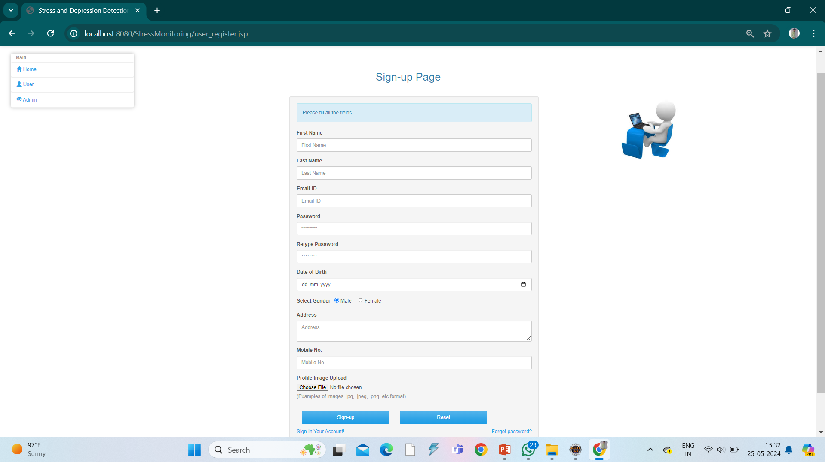
Screen shots of implemented modules of project
Registration Page

Slide 22
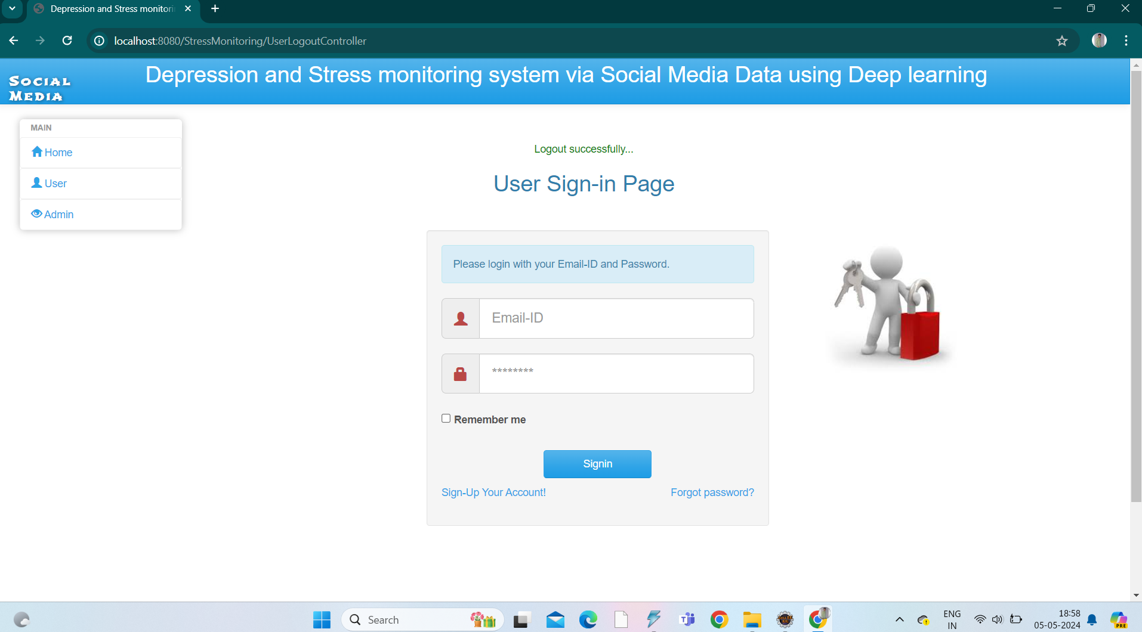
Screen shots of implemented modules of project
Login Page

Slide 23
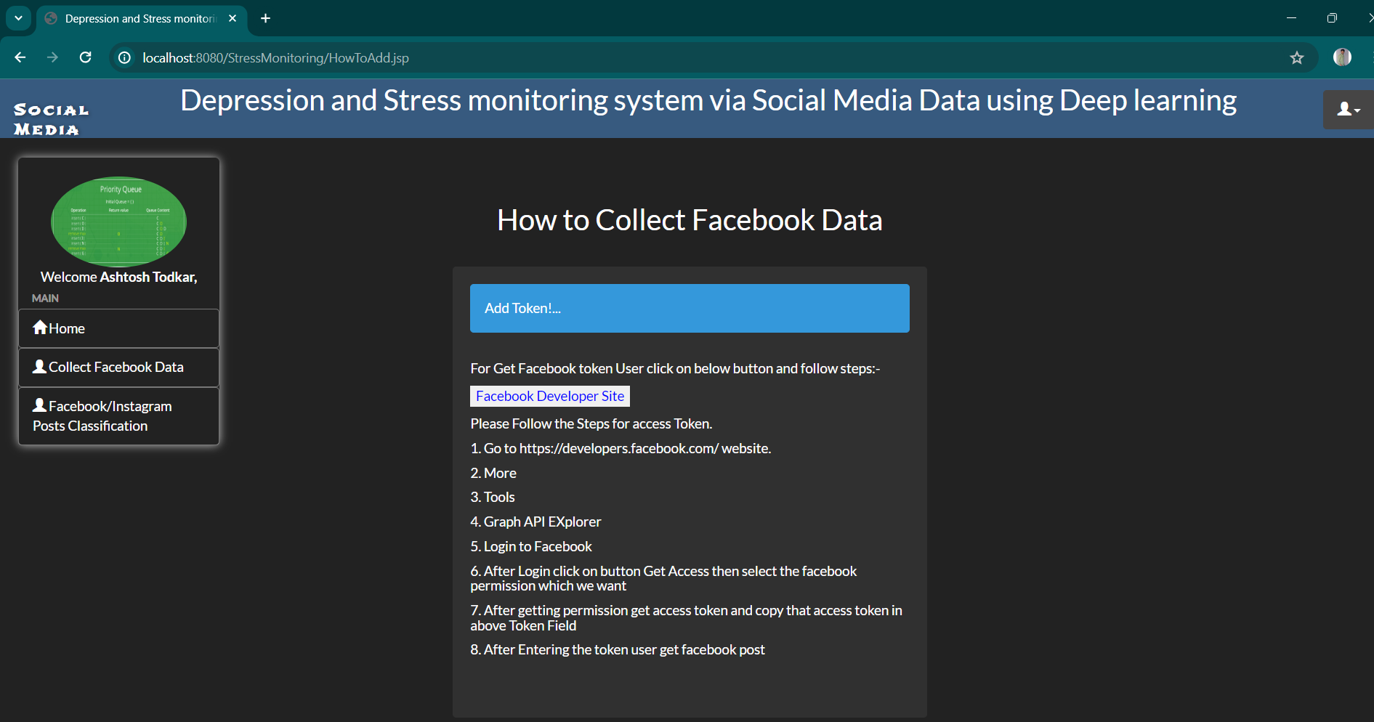
Screen shots of project output

Slide 24
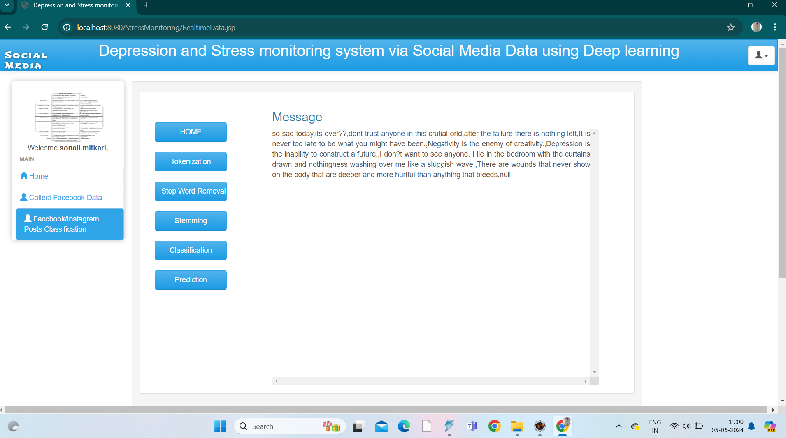
Screen shots of project output

Slide 25
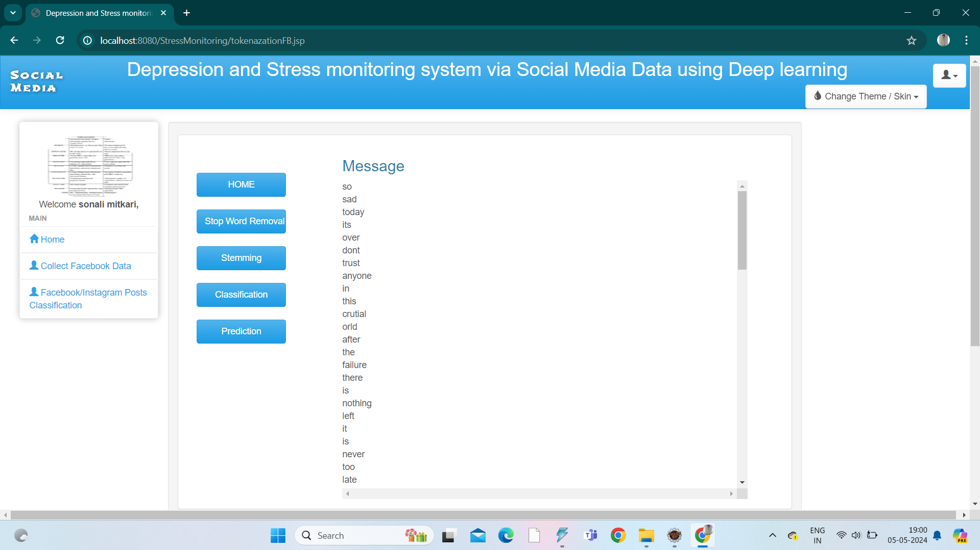
Screen shots of project output

Slide 26
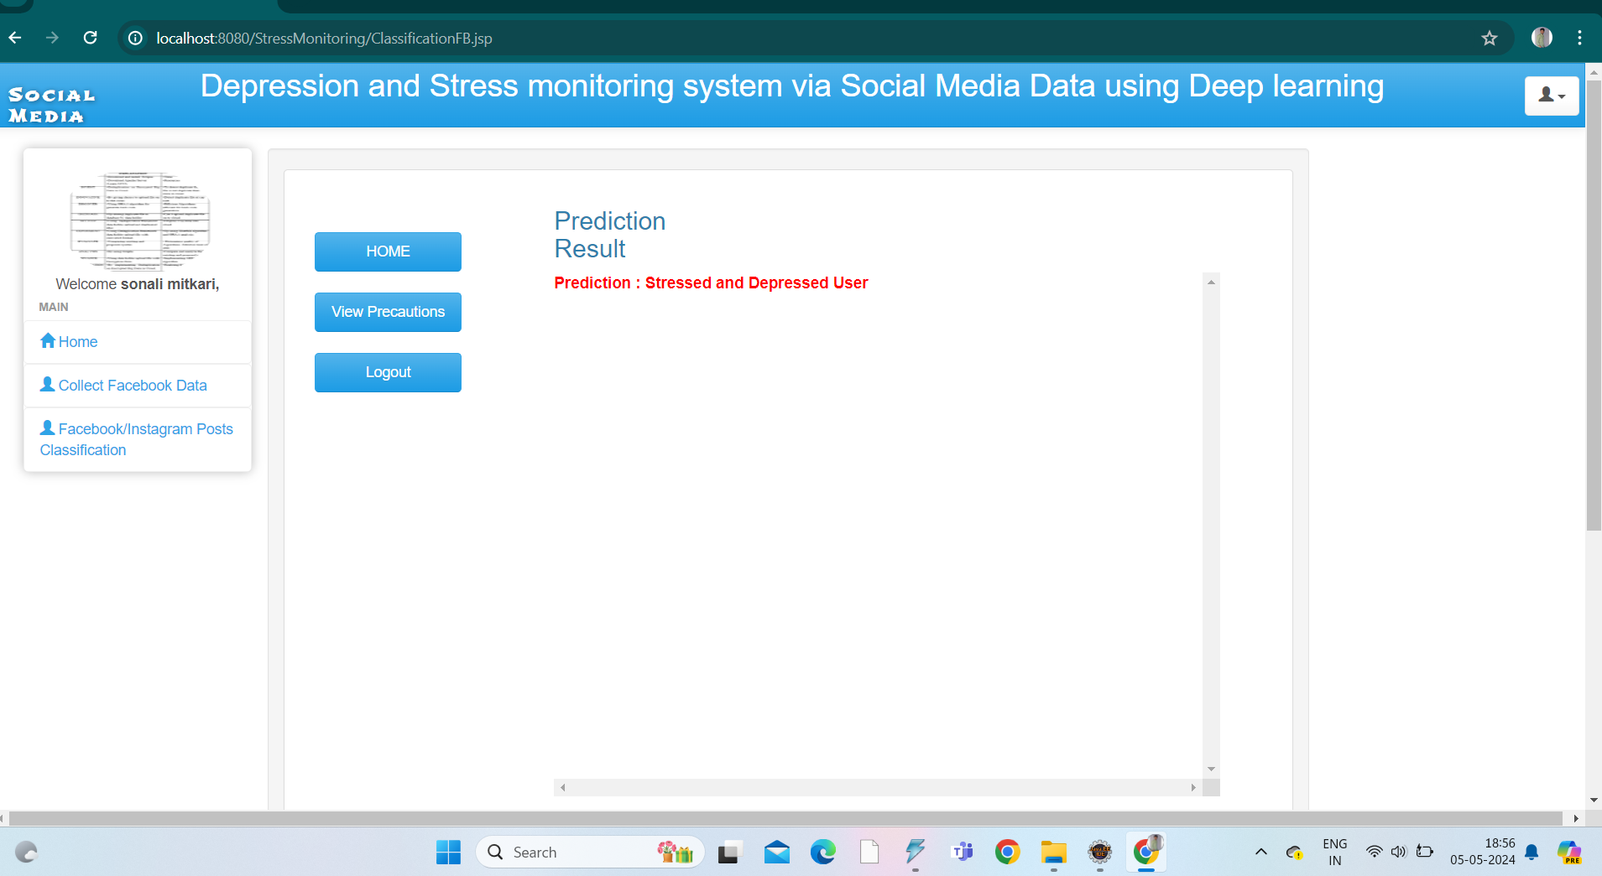
screen shots of project output

Slide 27
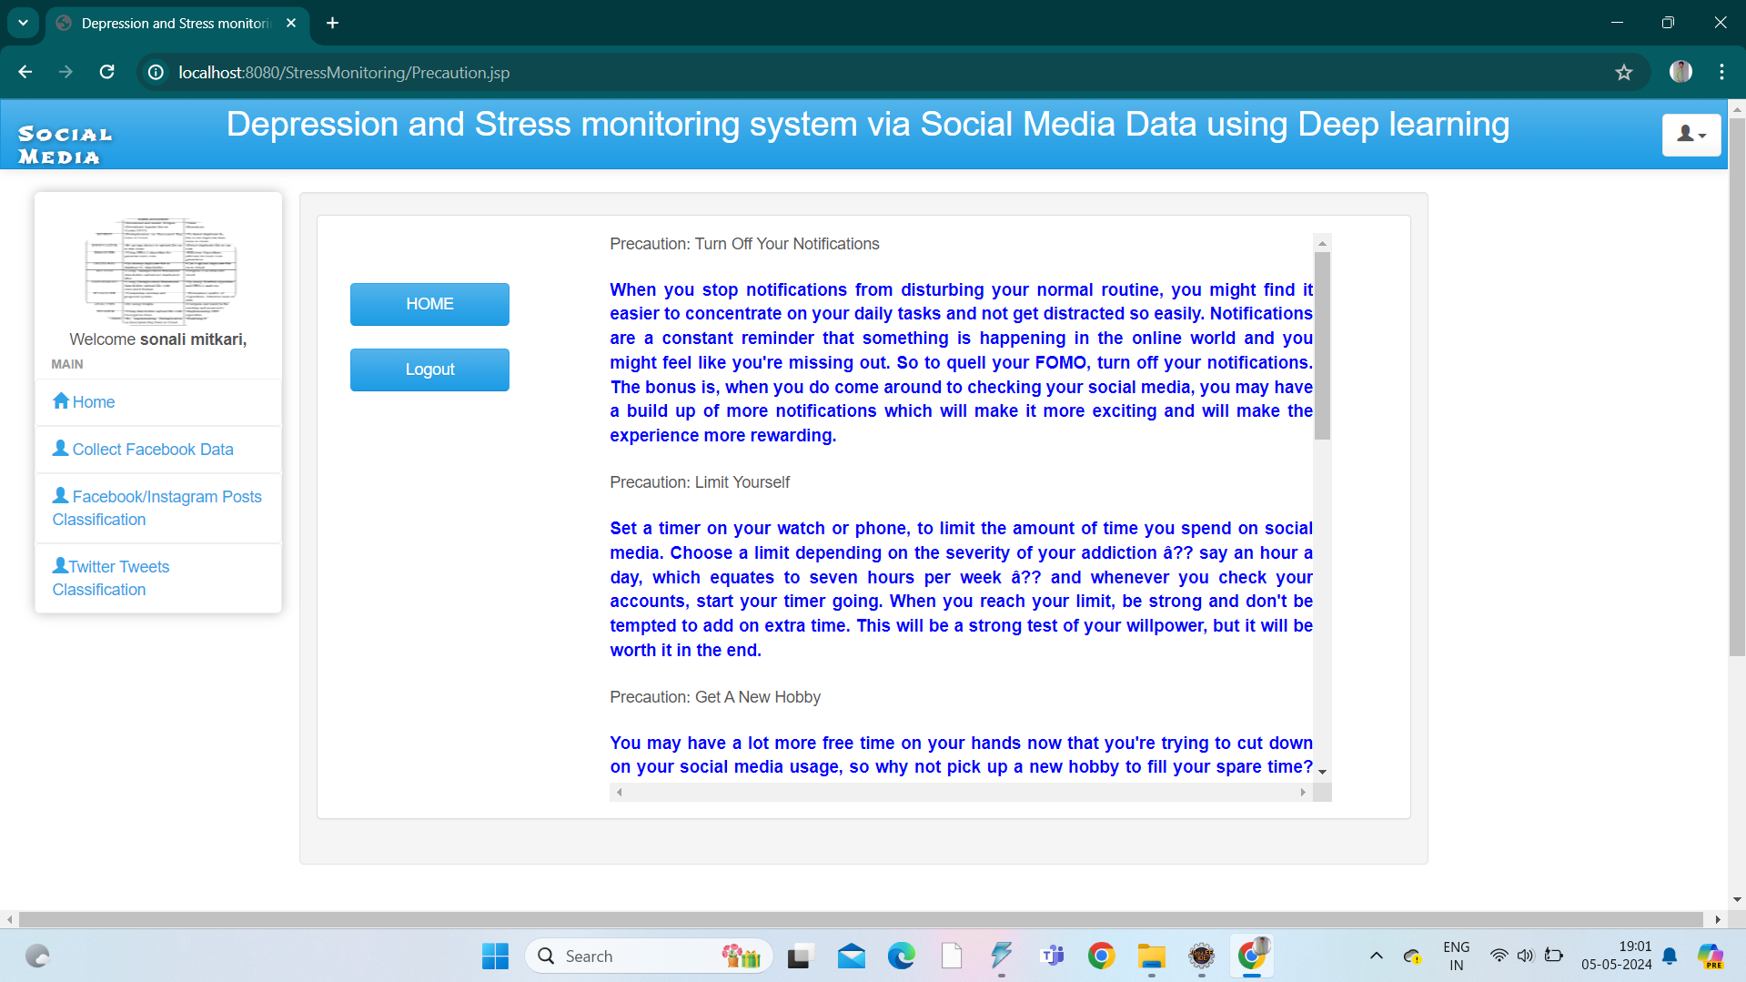
screen shots of project output

Slide 28
ADVANTAGES
Design and develop web application for early stress detection.
Classification of depressed and stressed user by using deep learning algorithms.
Get positive and negative comments using sentiment analysis.
Machine learning algorithms can identify signs of stress and depression early, allowing for timely intervention and support.
Social media platforms have a vast user base, making it possible to reach a large population and provide support to those in need.
Automated detection through machine learning reduces the need for manual screening, making it a cost-effective solution for identifying mental health issues.

Slide 29
LIMITATIONS
Bias and Representativeness.
Users may be uncomfortable with their data being used for analysis
complexity of language and the various ways people express their emotions
ML algorithm may struggle to understand context surrounding social media posts, leading to misinterpretation of emotions.
Access to social media data for research purpose might be restricted.
Mental health states can fluctuate over time, and social media posts may not always reflect users' current emotional states.

Slide 30
CONCLUSIONS
In this proposed system, automatically identifying potential online users with depression and stress is threatening people's health.
Thus users suffering from depression can be identified and they might be helped before they take any drastic steps which might have a long lasting impact.
Using the data of the social networks of the real world as a basis, we study the correlation between the states of psychological disorder of users and their social interaction behaviour we recommend the user for health precautions to send by mail for user interaction.

Slide 31
FUTURE WORK
More accurate and reliable machine learning models for stress and depression detection can be created by continued research.
Incorporating advanced NLP techniques& multimodal data fusions like text, images and videos can improve model performance.
Implement advanced user feedback for better personalization.
enabling real-time intervention and support for individuals at risk of stress and depression.
Enhance privacy and security measures.
Incorporate voice recognition for stress detection.

Slide 32
LIST OF PUBLICATIONS
Paper 1
Publication Name : International Research Journal of Modernization in Engineering Technology and Science
ISSN No. : 2582-5208
Paper 2
Publication Name : International Journal of All Research Education & Scientific Methods
ISSN No. : 2455-6211

Slide 33
REFERENCES
Renata L. Rosa, Gisele M. Schwartz, Wilson V. Ruggiero, and Dem´ostenes Z. Rodr´ıguez, Senior Member, IEEE” A Knowledge-Based Recommendation System that includes Sentiment Analysis and Deep Learning” IEEE 2019.
Guang Yang, Haibo He, Fellow, IEEE, and Qian Chen” Emotion-Semantic Enhanced Neural Network” IEEE 2019.
M. Al-Qurishi, M. S. Hossain, M. Alrubaian, S. M. M. Rahman, and A. Alamri, “Leveraging analysis of user behavior to identify malicious activities in large-scale social networks,” IEEE Transactions on Industrial Informatics, vol. 14, no. 2, pp. 799–813, Feb 2018.
H. Lin, J. Jia, J. Qiu, Y. Zhang, G. Shen, L. Xie, J. Tang, L. Feng, and T. S. Chua, “Detecting stress based on social interactions in social networks,” IEEE Transactions on Knowledge and Data Engineering, vol. 29, no. 9, pp. 1820–1833, Sept 2017.
Budhaditya Saha, Thin Nguyen, Dinh Phung, Svetha Venkatesh” A Framework for Classifying Online Mental Health Related Communities with an Interest in Depression” IEEE 2016.

Slide 34
Thank you !!!

